Slide 1
TLEN 5700
Graduate Projects I
2018-2019 Candidate Graduate Projects
Course Website / Canvas
Course Milestones
Team Formation Considerations
Project Definition Document (PDD)
Kevin Gifford
August 29, 2018

Slide 2
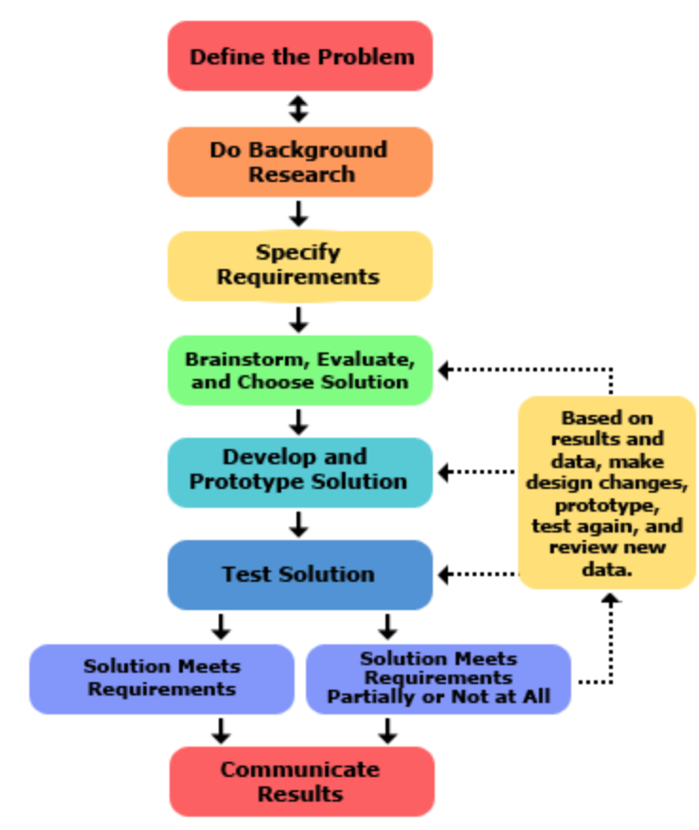
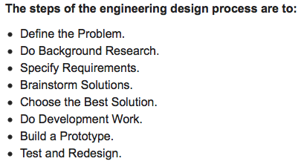
Engineering Design Definition
Engineering design is the process of devising a system, component, or process to meet desired needs. It is a decision-making process (often iterative), in which the basic science and mathematics and engineering sciences are applied to convert resources optimally to meet a stated objective.

Slide 3
Course Website
Canvas/D2L

Slide 4
Capstone Topics
Jose Santos
August 29, 2018

Slide 6
Capstone Topics
Levi Perigo
August 29, 2018

Slide 7
SDN Enterprise Network Orchestration Application: Net-O App
Cloud-based Network Automation, and Orchestration
OpenStack
Containers
Docker
K8s
SDN/NFV
Ansible
Python/REST API
Q&A testing

Slide 8
Voice-assisted, Intent-based, Self-healing Network
Amazon Alexa
SDN/NFV
VNFs
VMs/Containers
Network Automation and Orchestration
Quality of Service (QoS)
Network Troubleshooting
Telemetry data
Self-healing
TensorFlow

Slide 9
SDN/NFV VNF Service-chaining
Sponsor: Equinix
Cloud-based Network Automation and Orchestration (VNFs)
VNF service-chaining deployment and testing
Within single VNF (IPSec + NAT + FW on vSRX)
Between multiple vendor VNFs
VNF performance evaluation
VPN encryption
Throughput levels
OpenStack & KVM
Containers
Silicon Valley

Slide 10
Next Generation - SDN VoIP
Realtime Network Manipulation
SDN/NFV and VNFs
Network Automation & Virtualization
Softphones
Voice systems as VNFs in containers
Extremely Novel!
Low cost
High efficiency
Changing the VoIP game!
No prior VoIP knowledge

Slide 11
Big Data Analytics for Traditional Service Provider Networks
BDA
PNDA
Open BMP – BGP
Self-healing (script)
Contribute back
Make an immediate impact on the open source and ISP community

Slide 12
Capstone Topics
Lloyd Thrall
August 29, 2018

Slide 13
Envisioning the Internet of Things (IoT)
Interest: MD5, H4D
The introduction of the Internet of Things (IoT) has triggered an explosion of network communication globally. Many devices open connections to servers hosted by the manufacturing corporations, while other open connections to other IoT devices. Many of the protocols used by IoT devices to communicate are proprietary and non-standard. Being able to identify IoT devices, whom and what they are communicating with, and what their capabilities are could greatly assist network security analysts.
Thus, the team would develop a means to efficiently distinguish between IoT and non-IoT traffic, and identify specific types of IoT devices.
Possibly combine with Gnu-Radio scanner;
has applicability to Bluetooth as well

Slide 14
Subterranean Communication
Interest: MD5, H4D
Military, law enforcement, and disaster relief stakeholders currently struggle to reliably communicate data from caves, underground facilities, or rubble. While these stakeholders may be able to send small unmanned vehicles into subterranean environments, communicating the subsequent sensor data back to operators and decisionmakers in a timely manner is a challenge. This costs lives.
Thus, this team would develop a concept for providing near-real time data transmission through earth and traditional building materials from depths down to sixty feet, at a horizontal distance of up to 1,000 feet. Ideally, the concept would need its own power source, fit within a 2’x2’x2’ cube, and weigh less than 15 lbs.

Slide 15
Capstone Topics
Dr. David Reed
August 29, 2018

Slide 16
Comparison of Last Mile Wireless Platforms in Emerging Countries
New technologies to deliver broadband to underserved and unserved areas
LTE, Wi-Fi, Stratospheric, and Satellite
Techno-economic study of costs and capabilities of new platforms to identify likely coverage gaps
CBEE

Slide 17
Google Fiber: What Went Wrong?
Analysis of Google Fiber strategy
Gbps technical approach
Business model innovations and barriers
Implications for future FTTH efforts (e.g., muni fiber)

Slide 18
An Engineering, Economic, and Policy Analysis of Open Access Networks/Municipal Broadband
Analysis of the Open Access Network and Muni Broadband Strategies
Few open access broadband networks in operation – why?
Business model innovations and barriers
Technology: Open source transport platform based upon SDN

Slide 19
Growing Debate on Digital Privacy: Update on Web Tracking and User Concerns
Empirical Study of Web Cookies (latest study from 2015/16)
Trends in tracking technologies
Mapping to privacy policies
Survey of student awareness/concerns

Slide 20
Adaptable Standards for TCP (Ken Krechmer, Adjunct)
Create the software for adding adaptability to a TCP/IP based communications system and put it on sourceforge.net. Possible communications system examples:
Blockchain system - adaptability supports multiple different blockchain technologies
An app in an app store - adaptability supports both proprietary (trademark controlled) and public (no trademark control) functions

Slide 21
Internet Corporation for Assigned Names and Numbers (ICANN) Policy Development Processes (Joe Catapano)
Temporary Specification on generic Top-Level Domain Names (gTLD) Registration Data (focuses on EU's General Data Protection Regulation and its effect on the WHOIS database)
Cross-Community Working Group on Auction Proceeds generated from new gTLD registrations
Review of All Rights Protection Mechanisms in all gTLDs
Next Generation gTLD Registration Directory Services to replace WHOIS
Examine themes in ICANN’s history project www.icann.org/history including ICANN's relationship with the US Government and its impacts on how ICANN operates globally
Examine benefits of multistakeholder Internet governance model and its applicability in other areas (e.g., how volunteer community works and how norms may differ from other global orgs)

Slide 22
Capstone Topics
Kevin Gifford
August 29, 2018

Slide 23
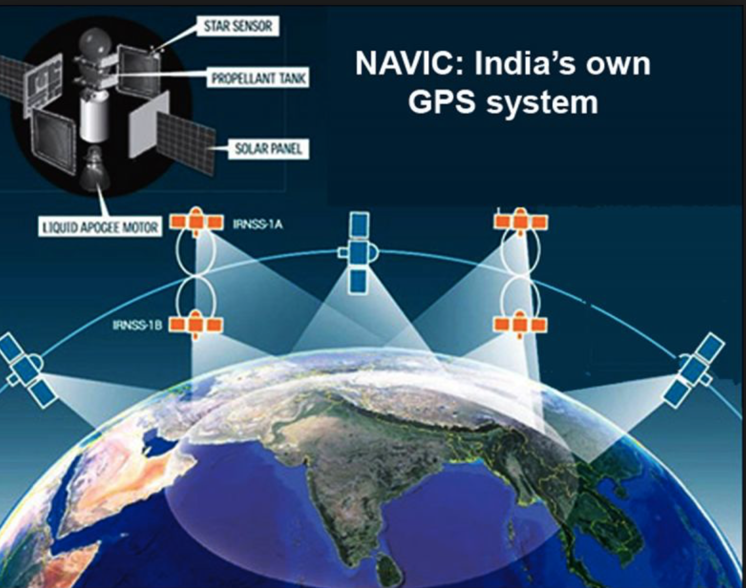
Design and Build-Out of spacecraft cybersecurity testbed
Sponsor: Aerospace Corp
The student team will:
• Become familiar with MIL-STD-1553 protocol, timing, and applications
• With assistance from Aerospace, determine the best platform for target implementation
• Implement baseline functionality for BM (Bus Monitor) and RT (Remote Terminal)
• Test and validate the MIL-STD-1553 implementation
• Demonstrate interaction between a simulated BM and one or more simulated RTs for a variety of MIL-STD-1553 protocol operations
• Provide reference MIL-STD-1553 code that can be ported to defined platform
Includes denial of spectrum…

Slide 24
Design and Build-Out of spacecraft cybersecurity testbed
Sponsor: Aerospace Corp

Slide 25
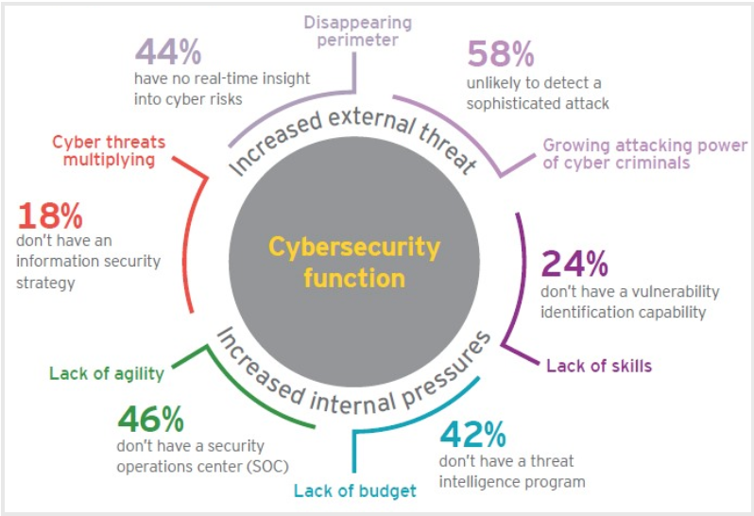
Cybersecurity Threat Detection for Spacecraft
Sponsor: Aerospace Corp
Aerospace is seeking advancements in real-time cyber security monitoring that could enhance cyber defenses on board future generation spacecraft.
Aerospace has developed a prototype platform for real-time security monitoring that leverages the Microblaze processor on a Xilinx FPGA.
The Aerospace Corporation is tasking the University of Colorado Boulder’s Interdisciplinary Telecom Program to research, build, and test applications that could run on top of that platform which could detect indicators of malicious cyber activity on the main spacecraft processor. The student team will develop demonstration cyber attacks targeting spacecraft and demonstrate successful detection and mitigation of those attacks.
Includes denial of spectrum…

Slide 26
Cybersecurity Threat Detection for Spacecraft
Sponsor: Aerospace Corp
Attack vectors should include, but are not limited to:
• Operating system rootkit installation
• Overwriting flight software in nonvolatile storage
• Permanently denying commanding to legitimate spacecraft operators by changing encryption keys
• Hijacking flight software control flow via stack smashing techniques
• Exfiltrating data
Detection and mitigation mechanisms should look for signs of these attacks by monitoring memory, storage, and network interfaces. The software should provide a configurable range of responses from generating alerts to halting the processor to block the attack. The security monitor should also provide operators with investigation tools to assess the extent of the attack. Tools such as Microsoft’s Windows Defender Exploit Guard and Linux grsecurity kernel patches may be useful inspiration for protection mechanisms.
Includes denial of spectrum…

Slide 27
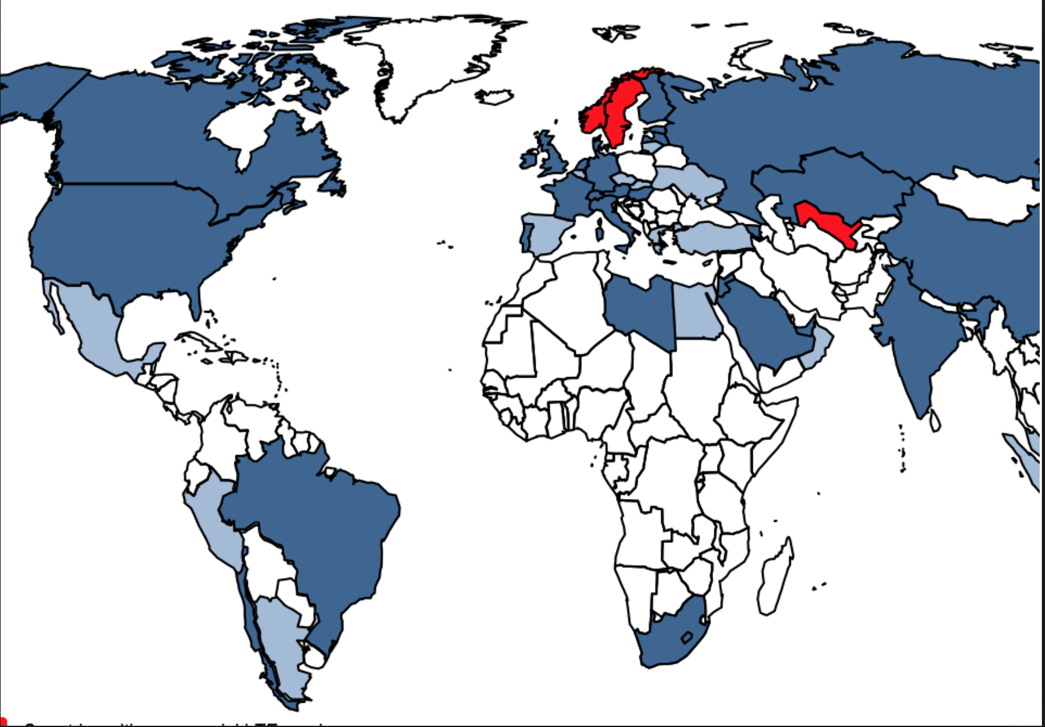
LTE network transmission power optimization
Interest: FaceBook, TIP
fb-open-cellular: LTE network transmission power optimization (i.e., wake up the backhaul)
Wireless transmission, scheduler intelligence with dynamic resource assignment and management

Slide 28
LTE scheduler optimization
Interest: FaceBook, TIP
fb-open-cellular: LTE scheduler optimization to trade off
#users
user experience
power consumption

Slide 29
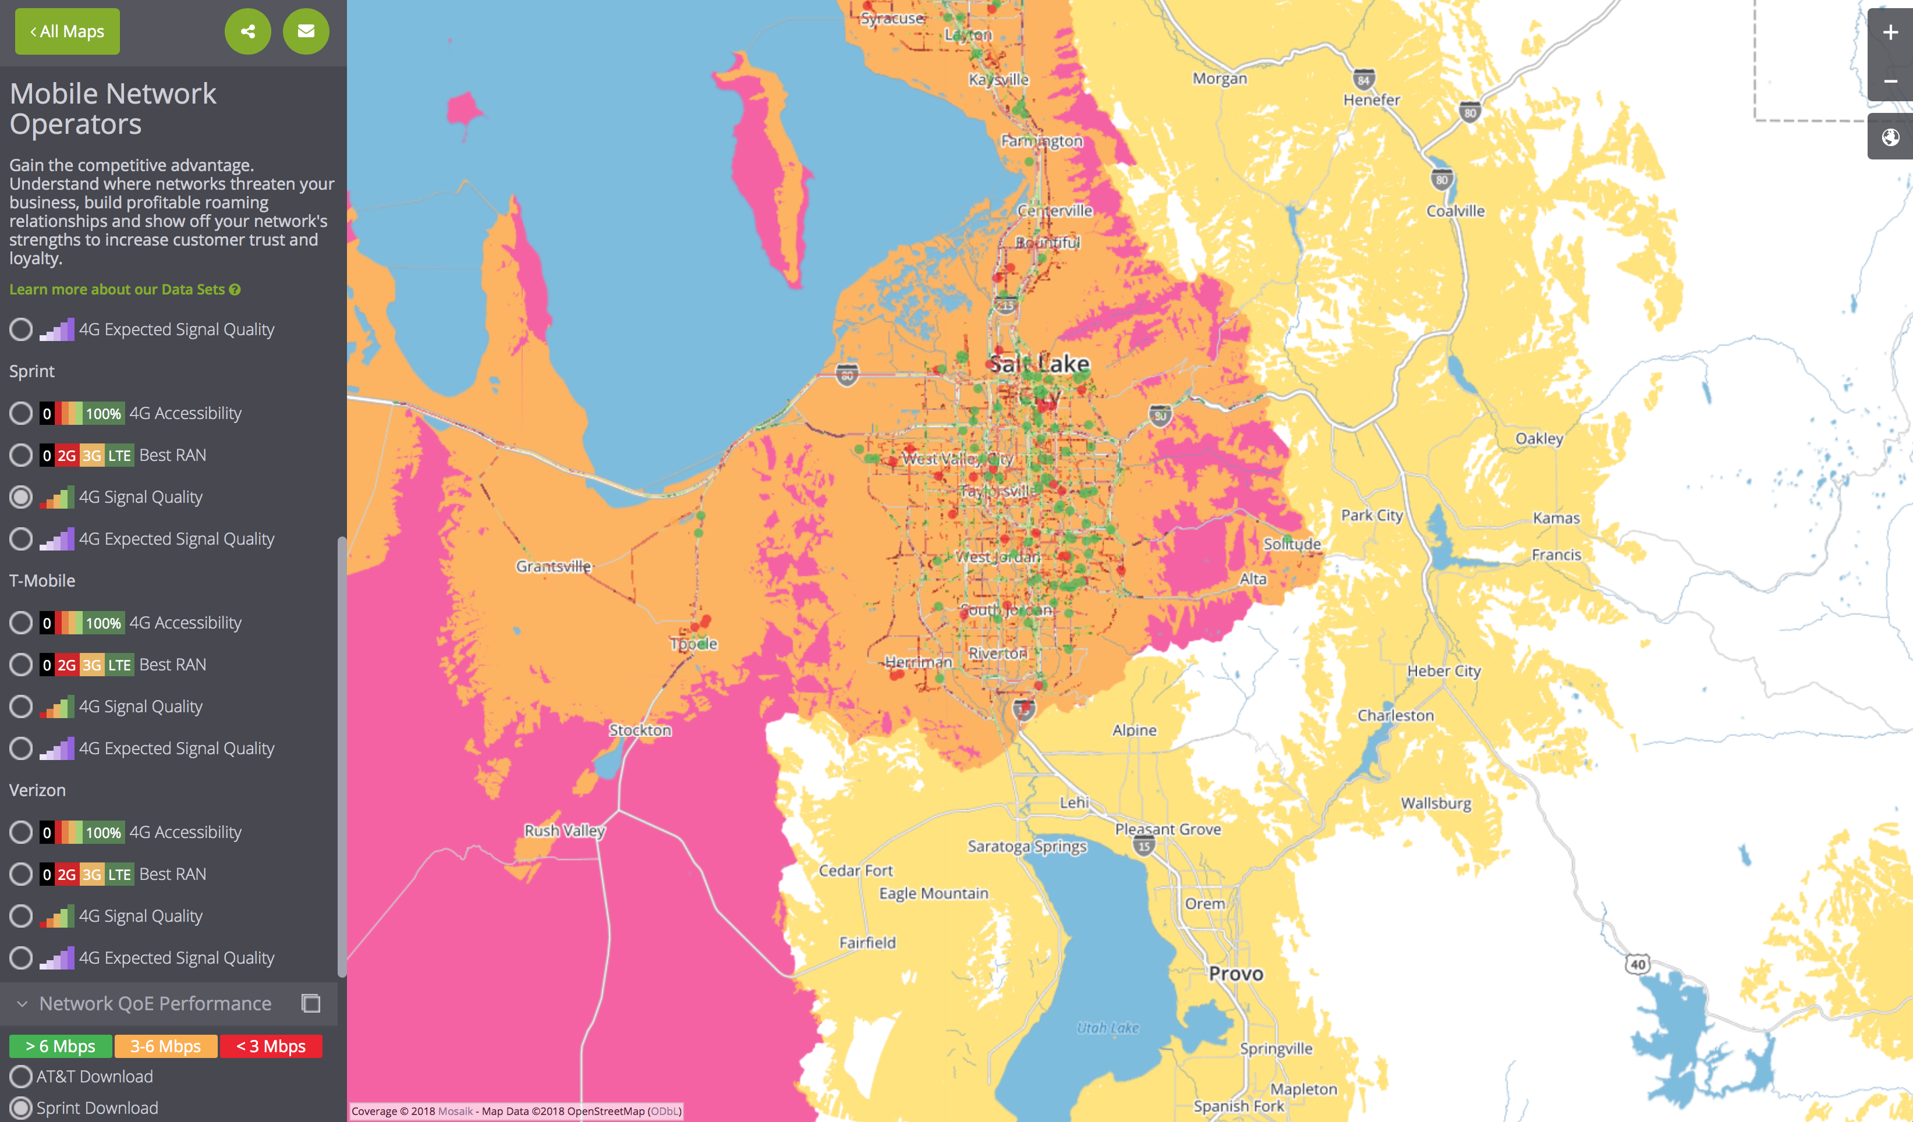
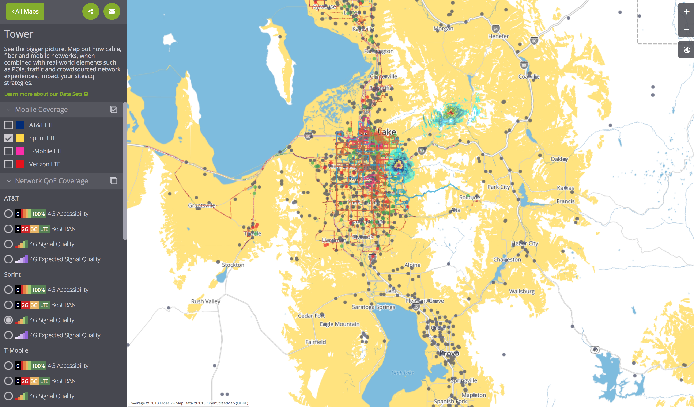
Wireless Network Analytics Platform
Interest: Oakla, Mosiak
Mosaik/Ookla Wireless Network Monitoring platform: comprehensive network analytics and monitoring for critical communications
Design, prototype, and provide an initial implementation of a comprehensive wireless network analytics framework in support of critical communications. The application domain drivers for the framework would be LTE/5G small cell deployments (CU/Zayo/Verizon) space, public safety and the CU wireless testbeds (CU, NIST Table Mountain)

Slide 30
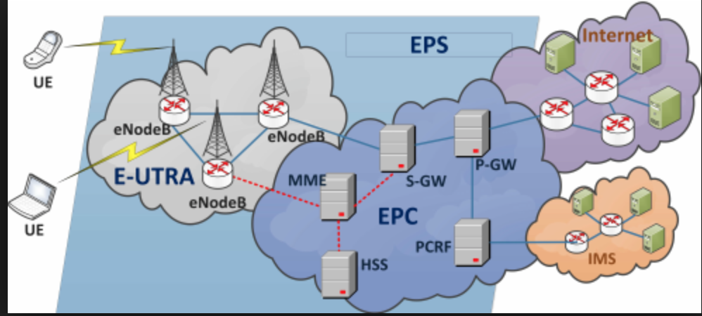
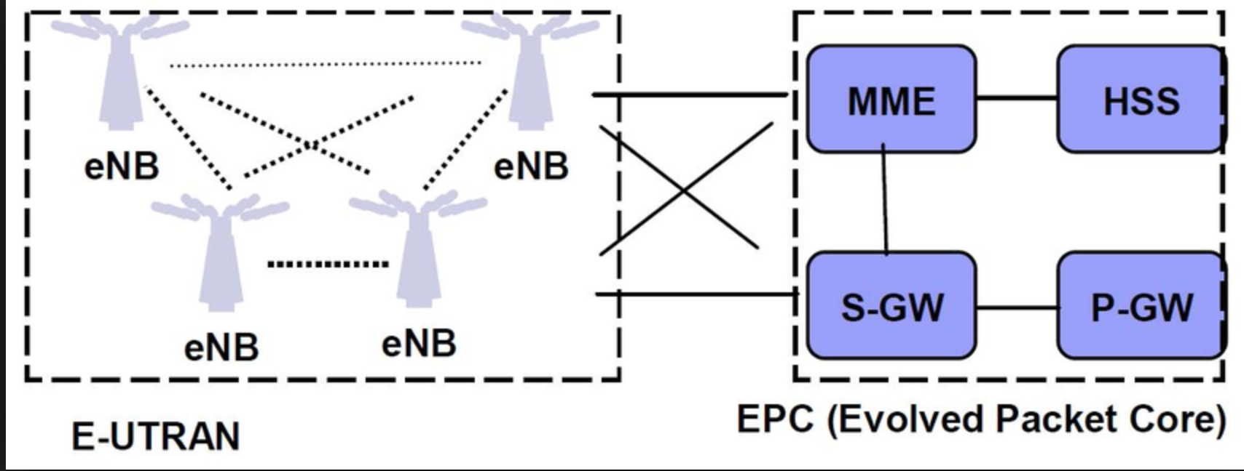
Advanced Networking: ICN and DTN for mobile networks
Sponsor: NIST, NASA
Native DTN-BP at the eNodeB/Access Point: Comparison of ICN and DTN: OpenEPC, fb-cellular, srs-LTE, TIP
Cellular wireless providers, NIST, NASA, public safety, advanced networking systems
ICN: local, DTN: relay
Advanced network engineering

Slide 31
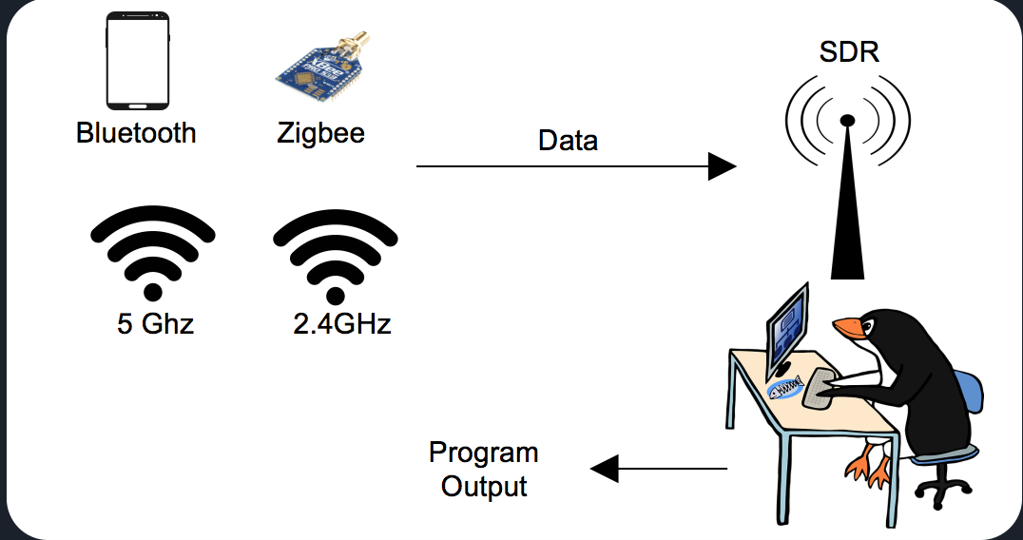
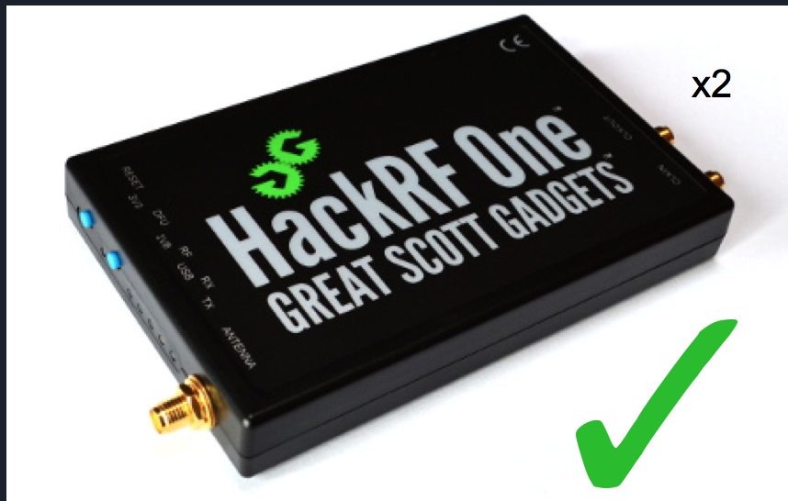
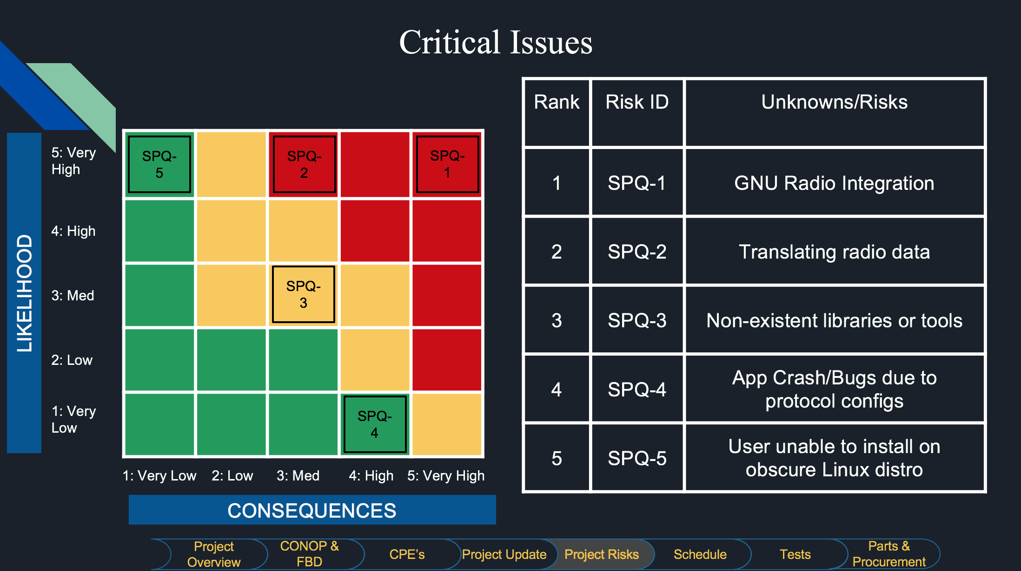
Bluetooth SDR scanner and utilities
Bose support
Bluetooth SDR scanner and utilities, Gnu-radio Bluetooth support, build off SuperFREQ, support Bluetooth-SIG v6 development & testing
Cyber, wireless, software development

Slide 32
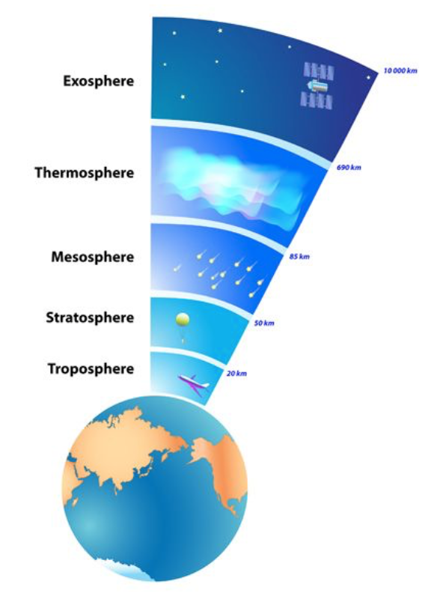
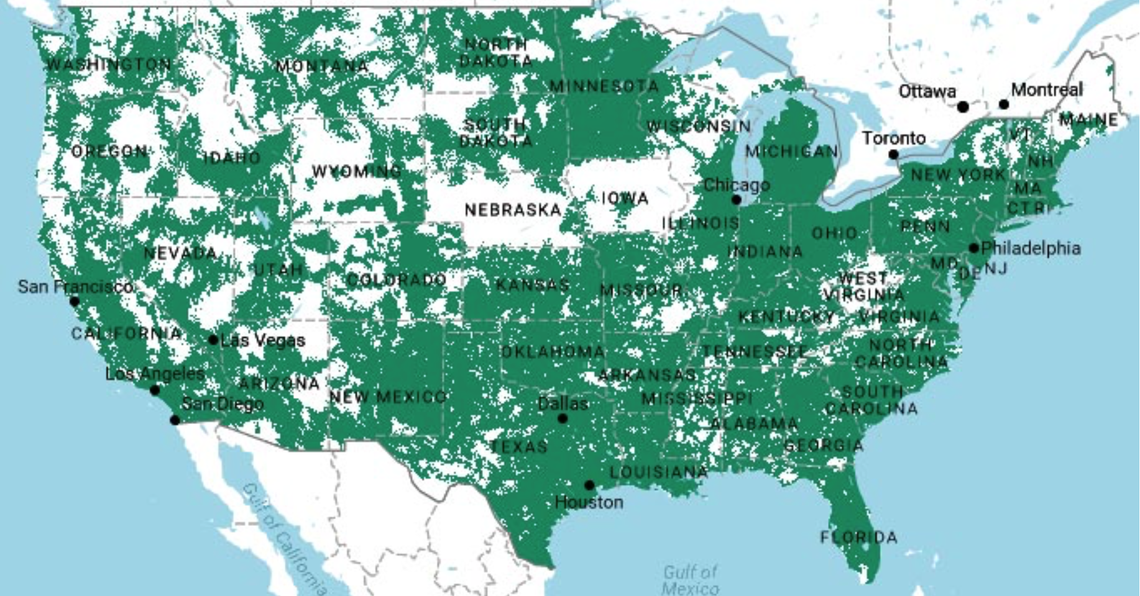
3D Wireless (aka, 3D LTE, 3D 5G)
3D support for LTE, 5G
Tremendous application domain space for applicability
Public Safety, Emergency response, remote sensing
Fundamental research and design for multi-node LTE/5G communications
Dynamic P2P networking, 3D free space wireless design, tremendous opportunity for fundamental mathematical modeling contributions in 3D

Slide 33
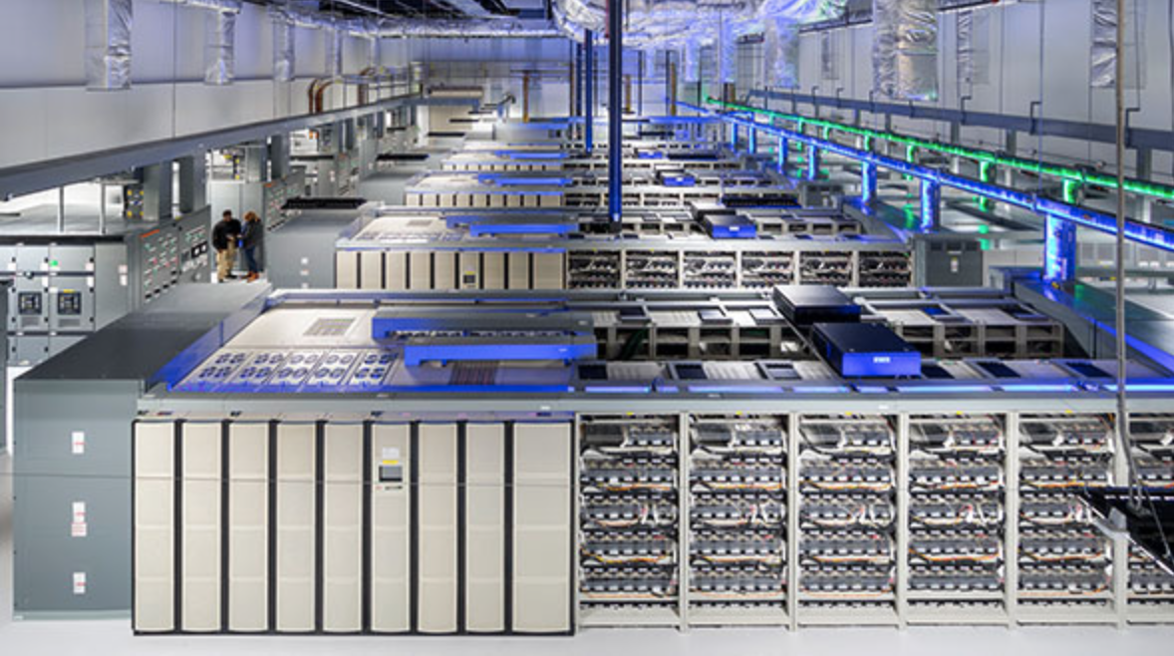
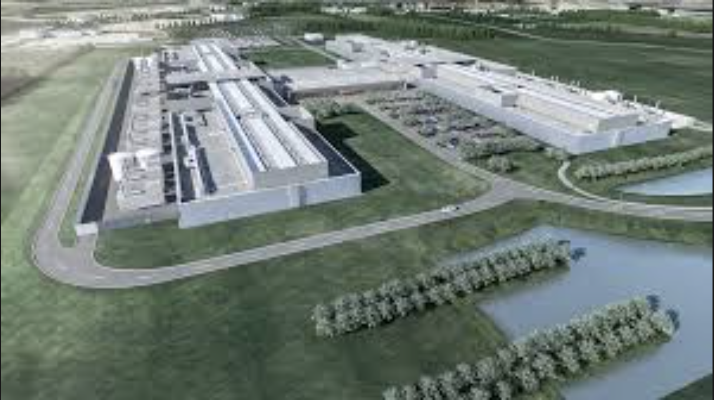
Data Center Infrastructure and Sustainability
Sponsor: Charles Schwab
Optimize power consumption
Design rack density and configuration management
Specify required process management
Predictive analytics
Data protection

Slide 34
2018-2019 Graduate Projects
Candidate topics
End

Slide 35
Team Formation Considerations
Number of team members: 3 to 6, with most teams having 4/5 team members.
(a) Let the students choose their own teams.
(b) Use the alphabetical class order in the register.
(c) Use the university student number code order.
(d) Select team members based on previous performance.
(e) Select groups based on a heterogeneous mixture, i.e. sex, age, nationality, specialization, etc.
(f) Select a team leader and let them pick one additional member in turn.
(g) Select team members based on sitting or standing position.
(h) Select team members based on astrological ‘star sign’ or month of birth.
(i) Select team members based on their Personality Type and/orLearningS tyle.
(j) Issue coded labels to students, who then form groups based on the codes.
See resources on course website.
Your team has the technical skills and capabilities required to execute the project.
Project Definition Document requires approval to go forward. The PAB may mandate team modifications in an effort to ensure equitability and success.
Example Project Definition Documents: CHIMERA, ANACONDA
Notes:
Planning Notes 11-Mar-2013:
Discuss SABL Project Plan with Shea and Louis
Coordinate dates for RSA 2FA TIM at HOSC (Shea, Jim, Shankini); cost share this trip with BioServe
Determine timeline on DTN2 Simulator – coordinate HOSC DTN2 G/W testing, test plan, with the HOSC
Will need to plan Automation support for additional BioServe SABL tasks
Have an IDSCam close-out sprint; can transition to SABL early as necessary
HOSC RSA 2FA meeting this week and travel coordination

Slide 36
Capstone Project Milestones
Sep 2017
Oct 2017
Nov 2017
Dec 2017
Topic
Presentations
Wed. Aug. 29th
Teams & advisors set
Wed. Sep 12
Draft PDD to Advisor
Friday, Sep. 21st 2359
Draft PDD to Instructor
Fri. Sep. 28th 2359
PDD
Wed. Oct 3rd
1559
CDD
Wed. Oct 17th
PDR
Wed. Nov. 14th
CDR
Wed
Dec. 5th / 12th

Slide 37
2018-2019 Graduate Projects Course Schedule
Wk | Class Date | Topic(s) | Assignment
1 | 29-Aug-2018 | Course Introduction; Project Topics, Team Formation
2 | 05-Sep-2018 | Team Formation, PDD, Customer Interaction, Team skills assessment
3 | 12-Sep-2018 | PDD Requirements and Design Drivers, Project Management intro | Assignment-01: Teams & advisor; Wednesday, 12-Sep-2018, 1500
4 | 19-Sep-2018 | More PDD discussions; Engineering Library and Business Library resources | Assignment-02: Draft PDD#1 to academic advisor; Friday, 21-Sep-2018, 2359
5 | 26-Sep-2018 | Team PDD discussions | Assignment-03: Draft PDD#2 to course instructor; Friday, 28-Sep-2018, 2359
6 | 03-Oct-2018 | Conceptual Design and the CDD | Assignment-04: PDD-Final to course instructor; Wednesday, 03-Oct-2018, 1500
7 | 10-Oct-2018 | Concept evaluation; trade matrices – simple, detailed
8 | 17-Oct-2018 | Concept evaluation; trade matrices – simple, detailed | Assignment-05: Draft CDD to course instructor; Wednesday, 17-Oct-2018, 1500
9 | 24-Oct-2018 | Project Management: Planning methodologies, resources, constraints, strategies for success; software development considerations | Assignment-06: CDD-Final to course instructor; Wednesday, 24-Oct-2018, 1500
10 | 31-Oct-2018 | Preliminary Design Review: Risk Assessment, Risk Mitigation techniques.
11 | 07-Nov-2018 |  | Assignment-07: Draft PDR slide deck to course instructor
12 | 14-Nov-2018 | PDR Presentations | Assignment-08: Final PDR slide deck to course instructor
 | 21-Nov-2018 | Fall Break – No Class
13 | 28-Nov-2018
14 | 05-Dec-2018 | CDR Presentations (scheduled to be posted) | Assignment-09: Final CDR package to course instructor; Monday, 03-Dec-2018 2359
15 | 12-Dec-2018 | CDR Presentations (scheduled to be posted)

Slide 38
Project Definition Document

Slide 39
Project Definition and Customer Interaction
Who precisely is the customer?
Who is the academic advisor?
Who is the industry advisor
What is the problem or need? What are the projected/anticipated benefits?
What are the customer requirements for the system or product? Can any constraints be identified?
What previous work has been done in this area?
Previous work: literature searches, business and engineering libraries, trade journals, professional society publications (e.g., IEEE, ACM, etc.), industry experts for inputs and guidance, web searches (e.g., ask Google), online tutorials…
What are the (“my”, “our”) project requirements?

Slide 40
Capstone Project Milestones: Project Definition Document
Project Definition Document (PDD): The Project Definition Document (PDD) forms the technical foundation for a design project. Its purpose is to clearly define the design problem that will be solved, and to ensure the design team has the requisite resources and capabilities.
The design problem definition consists of an articulation of the need being served, specific objectives and levels of success for the design to satisfy this need in the context of the design course, and specific functional requirements the design must provide to satisfy those objectives.
Team capabilities and resources are assessed relative to an initial analysis of the critical project elements (“tall poles”) that must be addressed for a successful design solution.
This assignment should be approached in the order given, i.e. define the problem and research related work before the specific objectives (requirements) are identified.

Slide 41
Capstone Project Milestones: Project Definition Document
The PDD is developed in cooperation with the project customer, and represents a common understanding of the project focus, functional requirements, scope, and deliverables.
Customer approval is due at the time of PDD submission. Deviations from the set of objectives provided here will not be permitted without customer and advisor approval in the form of a revised PDD.
The Projects Advisory Board (PAB) will review the PDD for clarity of purpose and credibility of the critical project elements, together with the corresponding team capabilities and resources.
The PAB will issue a judgment of “acceptable” or “not acceptable” for readiness to begin the conceptual design phase, along with specific feedback on weak PDD components. Only teams with an “acceptable” PDD will be permitted to continue with the design process leading toward the Preliminary Design Review (PDR). Others must revise the PDD until an “acceptable” project definition is obtained.

Slide 42
Use Cases (engineering) and User Stories (agile methodologies)
A user story is a tool used in Agile software development to capture a description of a software feature from an end-user perspective. The user storydescribes the type of user, what they want and why. A user story helps to create a simplified description of a requirement.
User stories are part of an agile approach that helps shift the focus from writing about requirements to talking about them. All agile user stories include a written sentence or two and, more importantly, a series of conversations about the desired functionality. A user story is a very high-level definition of a requirement, containing just enough information so that the developers can produce a reasonable estimate of the effort to implement it.
_______________________________________________________________________
In software and systems engineering, a use case is a list of actions or event steps typically defining the interactions between a role (known in the Unified Modeling Language as an actor) and a system to achieve a goal. The actor can be a human or other external system.
Notes:
Planning Notes 11-Mar-2013:
Discuss SABL Project Plan with Shea and Louis
Coordinate dates for RSA 2FA TIM at HOSC (Shea, Jim, Shankini); cost share this trip with BioServe
Determine timeline on DTN2 Simulator – coordinate HOSC DTN2 G/W testing, test plan, with the HOSC
Will need to plan Automation support for additional BioServe SABL tasks
Have an IDSCam close-out sprint; can transition to SABL early as necessary
HOSC RSA 2FA meeting this week and travel coordination

Slide 43
Use Cases (Engineering)
CCSDS 880.0-G-3 File size 5834 KB
Wireless Network Communications Overview for Space Mission Operations. Green Book. Issue 3. May 2017.
https://public.ccsds.org/Pubs/880x0g3.pdf
USE CASES .................................................................................................................... 3-1
3.1 GENERAL ................................................................................................................ 3-1
3.2 INVENTORY MANAGEMENT PROBLEM DOMAIN AND USE CASES ....................... 3-1
3.3 SPACECRAFT WIRELESS COMMUNICATION PROBLEM
DOMAIN AND USE CASES ............................................................................................ 3-7
ANNEX D AUTOMATED LOGISTICS MANAGEMENT USE CASES .................................. D-1
ANNEX E SPACECRAFT USE CASES ............................................................................... E-1
ANNEX F HIGH DATA RATE WIRELESS NETWORK USE CASES ..................................... F-1
Notes:
Planning Notes 11-Mar-2013:
Discuss SABL Project Plan with Shea and Louis
Coordinate dates for RSA 2FA TIM at HOSC (Shea, Jim, Shankini); cost share this trip with BioServe
Determine timeline on DTN2 Simulator – coordinate HOSC DTN2 G/W testing, test plan, with the HOSC
Will need to plan Automation support for additional BioServe SABL tasks
Have an IDSCam close-out sprint; can transition to SABL early as necessary
HOSC RSA 2FA meeting this week and travel coordination

Slide 44
Requirements Generation (Definition)
The activities involved in requirements engineering vary widely, depending on the type of system being developed and the specific practices of the organization(s) involved. These may include:
Requirements inception or requirements elicitation - Developers and stakeholders meet, the latter are inquired concerning their needs and wants regarding the software product.
Requirements analysis and negotiation - Requirements are identified (including new ones if the development is iterative) and conflicts with stakeholders are solved
System modeling - Some Engineering fields (or specific situations) require the product to be completely designed and modeled before its construction or fabrication starts and, therefore, the design phase must be performed in advance.
Aerospace systems vs. software development analogy
Requirements specification - Requirements are documented in a formal artifact called Requirements Specification (RS).
Requirements validation - Checking that the documented requirements and models are consistent and meet the needs of the stakeholder. Only if the final draft passes the validation process, the RS becomes official.

Slide 45
Back-up Slides

Slide 46
Capstone Project Milestones: Project Definition Document
Project Definition Document (PDD): The Project Definition Document (PDD) forms the technical foundation for a design project. Its purpose is to clearly define the design problem that will be solved, and to ensure the design team has the requisite resources and capabilities. The design problem definition consists of an articulation of the need being served, specific objectives and levels of success for the design to satisfy this need in the context of the design course, and specific functional requirements the design must provide to satisfy those objectives. Team capabilities and resources are assessed relative to an initial analysis of the critical project elements (“tall poles”) that must be addressed for a successful design solution. This assignment should be approached in the order given, i.e. define the problem and research related work before the specific objectives are identified.
The PDD is developed in cooperation with the project customer, and represents a common understanding of the project focus, functional requirements, scope, and deliverables. Customer approval is due at the time of PDD submission. Deviations from the set of objectives provided here will not be permitted without customer and advisor approval in the form of a revised PDD.
The Projects Advisory Board (PAB) will review the PDD for clarity of purpose and credibility of the critical project elements, together with the corresponding team capabilities and resources. The PAB will issue a judgment of “acceptable” or “not acceptable” for readiness to begin the conceptual design phase, along with specific feedback on weak PDD components. Only teams with an “acceptable” PDD will be permitted to continue with the design process leading toward the Preliminary Design Review (PDR). Others must revise the PDD until an “acceptable” project definition is obtained.

Slide 47
Engineering Design (Applied Research) Definition

