Slide 1
TLEN 5830 Wireless Systems
Lecture-01
28-August-2018
Primary Topics:
Course Introduction and Overview
Course website; homework logistics (10% rule); in-class hand-in of assignments; laboratory hands-on exercises
Course Expectations
Course participants: self-introduction, background, wireless communications interests
Why wireless communications is different

Slide 2
Additional reference materials
Optional References:
Antennas and Propagation for Wireless Communication Systems, by Simon R. Saunders and Alejandro Aragon-Zavala, ISBN 978-0-470-84879-1; March 2007 (2nd edition).
Wireless Communications and Networks, by William Stallings, ISBN 0-13-040864-6, 2002 (1st edition);
Wireless Communication Networks and Systems, by Corey Beard & William Stallings (1st edition); all material copyright 2016
Wireless Communications Principles and Practice, by Theodore S. Rappaport, ISBN 0-13-042232-0 (2nd edition)

Slide 3
Wireless Network Engineering Track
Prepare students for a rewarding and successful career as leaders in the wireless industry
To meet this objective, courses are:
  Apply theory to practice: Multiple hands-on lab-based courses
  Computationally rigorous
  Research oriented
  Skills based
Skills include a broad range, from embedded systems and communication theory to practical wireless engineering fundamentals
Technology Centric, with an awareness of Business and Policy
Main goal: Emphasize design principles and modern digital wireless networking engineering methodologies

Slide 4
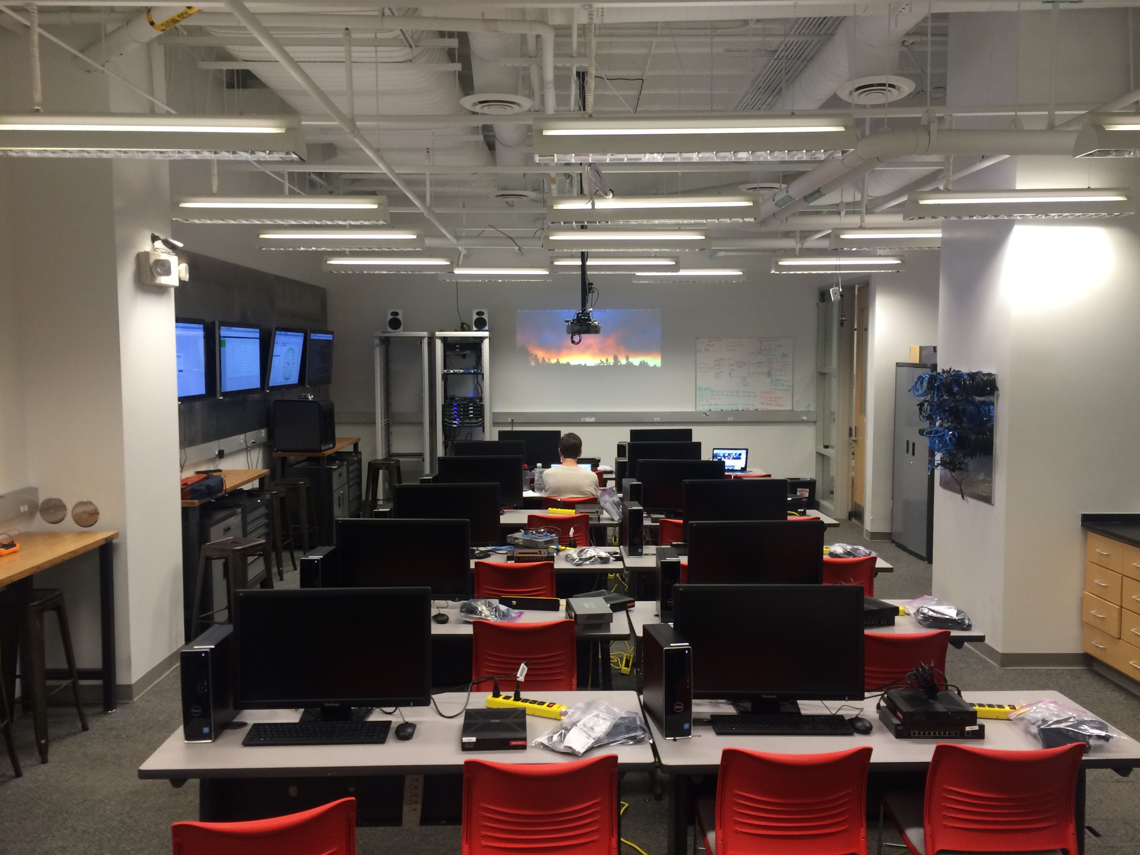
Research amenities and facilities: Lab Infrastructure & Equipment
Agilent Handheld Spectrum Analyzers
RF Propagation and Modeling licensed software: EDX, Wireless InSite, Planet
USRP SDRs: N210, B210
Gnu Radio, MatLab, LabView
Dedicated workstations: Linux, Windows PCs
Commercial-grade MOXA 4131-AWK radio(s): 2.4 GHz and 5GHz (802.11n)
Wi-Gig commercial-grade A.P.s (802.11ad)
802.11ac A.P.s
LTE Infrastructure eNBs, EPCs, UEs
  eNBs: Airspan, VirtualNetComm, USRP (Amarisoft)
  EPCs: Aricent, VirtualNetComm, Amarisoft (CND OpenEPC, Nokia)
  UEs: Moto-G4, Nexus 5 phones
Mobile Wi-Max: University EBS (2500 MHz)

Slide 5
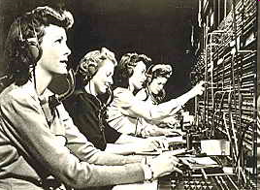

Evolution of terrestrial networking: circuit-switched to packet-switched

Slide 6
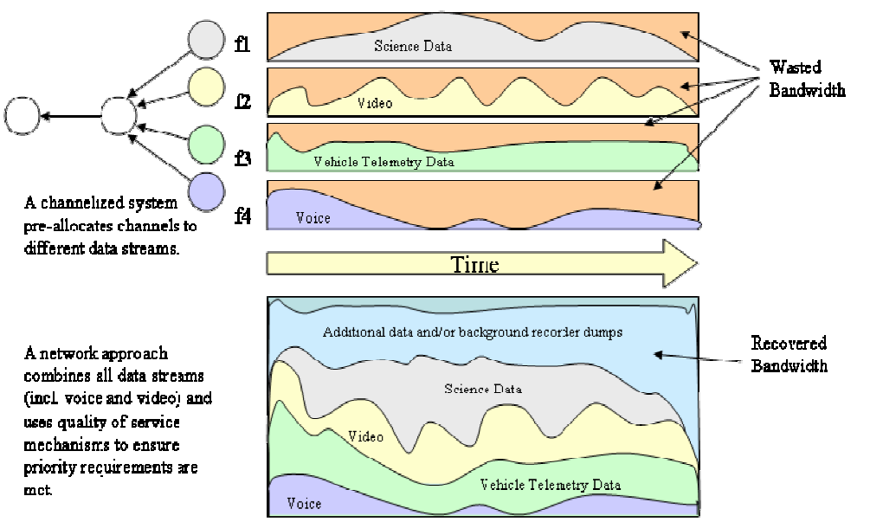
Why packetized communications?
CxP 70022-01, C3I Interoperability Standards Book, Vol.1, pg. 15

Slide 7
General properties of wireless networks
Class Question: Name key properties that make wireless networking different
than wired networking
Wireless Communications
Mobility: Communicate in ways you couldn’t accomplish otherwise
Cheaper: eliminate infrastructure of wired systems, lower cost links
Easier to broadcast:
  Provides a relatively low cost of content distribution
  Can add users in a cost-effective manner (point-to-multipoint)
CxP 70022-01, C3I Interoperability Standards Book, Vol.1, pg. 15

Slide 8
Wireless data networks
Class Question: Let’s name the majority of the major wireless data
networks/categories:
Wireless Data Networks
Many transmitters and receivers
Users can be mobile (dynamic, not static networks)
Communications are packet-based
  10 years ago: cellular systems had lots of low-capability devices and focus was on voice (connection-oriented) communications
  Now, in wireless data communications: intelligence is more distributed
  Importantly, characteristics of wireless cannot be compartmentalized: all OSI layers can be affected
CxP 70022-01, C3I Interoperability Standards Book, Vol.1, pg. 15

Slide 9
Wireless comes of age
Guglielmo Marconi invented the wireless telegraph in 1896
  Communication by encoding alphanumeric characters in analog signal
  Sent telegraphic signals across the Atlantic Ocean
Communications satellites launched in 1960s
Advances in wireless technology
  Radio, television, mobile telephone, mobile data, communication satellites
More recently
  Wireless networking, cellular technology, mobile apps, Internet of Things

Slide 10
Cellular Telephony
Started as a replacement to the wired telephone
Early generations offered voice and limited data
Current third and fourth generation systems
  Voice
  Texting
  Social networking
  Mobile apps
  Mobile Web
  Mobile commerce
  Video streaming

Slide 11
Wireless impact
Profound
Shrinks the world
Always on
Always connected
Changes the way people communicate
  Social networking
Converged global wireless network

Slide 12
Some milestones in wireless communications

Slide 13
Global cellular network(s)
Growth
  11 million users in 1990
  Over 7 billion today
Mobile devices
  Convenient
  Location aware
  Only economical form of communications in some places

Slide 14
Global cellular network(s)
Generations
  1G – Analog
  2G – Digital voice
    Voice services with some moderate rate data services
  3G – Packet networks
    Universal Mobile Phone Service (UMTS)
    CDMA2000
  4G – New wireless approach (OFDM)
    Higher spectral efficiency
    100 Mbps for high mobility users
    1 Gbps for low mobility access
    Long Term Evolution (LTE) and LTE-Advanced

Slide 15
Mobile device revolution
Originally just mobile phones
Today’s devices
  Multi-megabit Internet access
  Mobile apps
  High megapixel digital cameras
  Access to multiple types of wireless networks
    Wi-Fi, Bluetooth, 3G, and 4G
  Several on-board sensors
Key to how many people interact with the world around them

Slide 16
Mobile device revolution
Better use of spectrum
Decreased costs
Limited displays and input capabilities
Tablets provide balance between smartphones and PCs
Long distance
  Cellular 3G and 4G
Local areas
  Wi-Fi
Short distance
  Bluetooth, ZigBee

Slide 17
Future Trends
LTE-Advanced and gigabit Wi-Fi now being deployed
LTU and associated research currently very active
Machine-to-machine communications
  The “Internet of Things”
  Devices interact with each other
    Healthcare, disaster recovery, energy savings, security and surveillance, environmental awareness, education, manufacturing, and many others
  Information dissemination
    Data mining and decision support
  Automated adaptation and control
    Home sensors collaborate with home appliances, HVAC systems, lighting systems, electric vehicle charging stations, and utility companies.
  Eventually could interact in their own forms of social networking

Slide 18
Future Trends
Machine-to-machine communications
  100-fold increase in the number of devices
  Type of communication would involve many short messages
  Control applications will have real-time delay requirements
    Much more stringent than for human interaction

Slide 19
Future Trends
Future networks
  1000-fold increase in data traffic by 2020
  5G – Final definitions, standards, but envisioned by 2020
Technologies
  Network densification – many small cells
  Device-centric architectures - focus on what a device needs
  Massive multiple-input multiple-output (MIMO) – 10s or 100s of antennas
    To focus antenna beams toward intended devices
  Millimeter wave (mmWave) - frequencies in the 30 GHz to 300 GHz bands
    Have much available bandwidth.
    But require more transmit power and have higher attenuation due to obstructions
  Native support for machine to machine communication
    Sustained low data rates, massive number of devices, and very low delays.

Slide 20
What is 5G?
(eMBB)
(Massive M2M)
Low-latency, ultra-reliable (LLUR)

Slide 21
Mobile wireless communications market statistics
Mobile will represent 20% of total IP traffic by 2021
The average global mobile connection speed will surpass 20 Mbps by 2021
Smartphones will comprise 86% of mobile data traffic by 2021
By 2021 there will be 1.5 mobile devices per capita (phones, phablets)
By 2021, 4G/LTE will be 53% of connections and 79% of total traffic
By 2021, 5G will be 0.2% of connections (25M) and 1.5% of total traffic
The average smartphone will generate 6.8 GB of traffic per month by 2021, a four-fold increase the 2016 average of 1.6 GB per month

Slide 22
The trouble with wireless
Wireless is convenient and less expensive, but not perfect
Limitations and political and technical difficulties inhibit wireless technologies
Wireless channel
  Line-of-sight is best but not required
  Signals can still be received
    Transmission through objects
    Reflections off of objects
    Scattering of signals
    Diffraction around edges of objects

Slide 23
Characteristics of wireless data transmission
Very high signal attenuation (degradation)
Transmission is very noisy; subject to high BER
Broadcast channel is inherently insecure; no physical security to prevent spoofing
Wireless channel is not necessarily symmetric and are not transitive
  Remember the physical channel is symmetric
  But transmitters and receivers are not symmetric because of electronics, purpose, etc.
    If A can talk to B, it does not mean B can talk to A (symmetic)
    If A can talk to B, and B can talk to C, it does not mean A can talk to C (transitive)

Slide 24
Characteristics of wireless data transmission
Reflections can cause multiple copies of the signal to arrive
  At different times and attenuations
  Creates the problem of multipath fading
  Signals add together to degrade the final signal
Nodes are mobile so that the topology of the network is changing
  Causes intermittent link connectivity
  Doppler spread caused by movement
Interference from other users
Batteries, power management issues to account for
Radio spectrum is regulated

Slide 25
Focus of this course
Wireless Environment – In-depth understanding of general wireless communications
Modulation – use a signal format to send as many bits as possible
Error control coding – add extra bits so errors are detected/corrected
Adaptive modulation and coding – dynamically adjust modulation and coding to current channel conditions
Equalization – counteract the multipath effects of the channel
Multiple-input multiple-output systems – use multiple antennas
  Point signals strongly in certain directions
  Send parallel streams of data
Direct sequence spread spectrum – expand the signal bandwidth
Orthogonal frequency division multiplexing – break a signal into many lower rate bit streams
  Each is less susceptible to multipath problems

Slide 26
Electromagnetic spectrum of telecommunications

Slide 27
Political difficulties
Between companies
  Need common standards so products interoperate
  Some areas have well agreed-upon standards
    Wi-Fi, LTE
    Not true for Internet of Things technologies
Spectrum regulations
  Governments dictate how spectrum is used
    Many different types of uses and users
  Some frequencies have somewhat restrictive bandwidths and power levels
    Others have much more bandwidth available

Slide 28
Signals & Decibels

Slide 29
Electromagnetic Signals
  Function of time, e.g., for a general sine wave:
s(t ) = A sin(2πft + ϕ)
Can also be expressed as a function of frequency
  Signal consists of components of different frequencies
  This is an important insight for telecommunications RF understanding

Slide 30
Signals: Time domain concepts
Analog signal - signal intensity varies in a smooth fashion over time
  No breaks or discontinuities in the signal
Digital signal - signal intensity maintains a constant level for some period of time and then changes to another constant level
Periodic signal - analog or digital signal pattern that repeats over time
  s(t +T) = s(t) -∞ < t < +∞
    where T is the period of the signal

Slide 31
Signals: Analog and Digital waveforms

Slide 32
Signals: Time-domain concepts
Aperiodic signal - analog or digital signal pattern that doesn't repeat over time
Peak amplitude (A) - maximum value or strength of the signal over time; typically measured in volts
Frequency (f)
  Rate, in cycles per second, or Hertz (Hz) at which the signal repeats

Slide 33
Signals: Time-domain concepts
Period (T) - amount of time it takes for one repetition of the signal
  T = 1/f
Phase (ϕ) - measure of the relative position in time within a single period of a signal
Wavelength (λ) - distance occupied by a single cycle of the signal
  Or, the distance between two points of corresponding phase of two consecutive cycles

Slide 34
Signals: Sine Wave Parameters
General sine wave
  s(t ) = A sin(2πft + ϕ)
Slide-30 shows the effect of varying each of the three parameters
  (a) A = 1, f = 1 Hz, ϕ = 0; thus T = 1 s
  (b) Reduced peak amplitude; A=0.5
  (c) Increased frequency; f = 2, thus T = ½
  (d) Phase shift; ϕ = π/4 radians (45 degrees)
Note: 2π radians = 360° = 1 period

Slide 35
s(t) = A sin (2πft + ϕ)
Signals: Sine Wave Parameters

Slide 36
Signals: Frequency Domain Concepts
Fundamental frequency - when all frequency components of a signal are integer multiples of one frequency, it’s referred to as the fundamental frequency
Spectrum - range of frequencies that a signal contains
Absolute bandwidth - width of the spectrum of a signal
Effective bandwidth (or just bandwidth) - narrow band of frequencies that most of the signal’s energy is contained in

Slide 37
Signals: Addition of frequency Components(T = 1/f)

Slide 38
Frequency Components of Square Wave
Signals: Frequency Domain Concepts
Any electromagnetic signal can be shown to consist of a collection of periodic analog signals (sine waves) at different amplitudes, frequencies, and phases
The period of the total signal is equal to the period of the fundamental frequency

Slide 39
Signals: Acoustic spectrum of speech and music

Slide 40
Signals: Relationship between Data Rate and Bandwidth
The greater the bandwidth, the higher the information-carrying capacity
Conclusions
  Any digital waveform will have infinite bandwidth (Why?)
  BUT the transmission system will limit the bandwidth that can be transmitted
  AND, for any given medium, the greater the bandwidth transmitted, the greater the cost
  HOWEVER, limiting the bandwidth creates distortions

Slide 41
Signals: Attenuation of Digital Signals

Slide 42
Data Communication Terms
Data - entities that convey meaning, or information
Signals - electric or electromagnetic representations of data
Transmission - communication of data by the propagation and processing of signals

Slide 43
Examples of Analog and Digital Data
Analog
    Video
    Audio
Digital
    Text
    Integers

Slide 44
Analog Signals
A continuously varying electromagnetic wave that may be propagated over a variety of media, depending on frequency
Examples of media:
  Copper wire media (twisted pair and coaxial cable)
  Fiber optic cable
  Atmosphere or space propagation (wireless!)
Analog signals can propagate analog and digital data

Slide 45
Digital Signals
A sequence of voltage pulses that may be transmitted over a copper wire medium
Generally cheaper than analog signaling
Less susceptible to noise interference
Suffer more from attenuation
Digital signals can propagate analog and digital data

Slide 46
Reasons for Choosing Data and Signal Combinations
Digital data, digital signal
  Equipment for encoding is less expensive than digital-to-analog equipment
Analog data, digital signal
  Conversion permits use of modern digital transmission and switching equipment
Digital data, analog signal (Wireless Systems focus!)
  Some transmission media will only propagate analog signals
  Examples include optical fiber, wireless, and satellite
Analog data, analog signal
  Analog data easily converted to analog signal

Slide 47
Analog Transmission
Transmit analog signals without regard to content
Attenuation limits length of transmission link
Cascaded amplifiers boost signal’s energy for longer distances but cause distortion
  Analog data can tolerate distortion
  Introduces errors in digital data

Slide 48
Digital Transmission
Concerned with the content of the signal
Attenuation endangers integrity of data
Digital Signal
  Repeaters achieve greater distance
  Repeaters recover the signal and retransmit
Analog signal carrying digital data
  Retransmission device recovers the digital data from analog signal
  Generates new, clean analog signal

Slide 49
Wireless Systems focus: Maximize channel capacity
Impairments, such as noise, limit data rate that can be achieved
For digital data, to what extent do impairments limit data rate?
Channel Capacity – the maximum rate at which data can be transmitted over a given communication path, or channel, under given conditions

Slide 50
Effects of Noise on a Digital Signal

Slide 51
Concepts Related to Channel Capacity
Data rate - rate at which data can be communicated (bps)
Bandwidth - the bandwidth of the transmitted signal as constrained by the transmitter and the nature of the transmission medium (Hertz)
Noise - average level of noise over the communications path
Error rate - rate at which errors occur
  Error = transmit 1 and receive 0; transmit 0 and receive 1

Slide 52
Nyquist Bandwidth
For binary signals (two voltage levels)
  C = 2B
With multilevel signaling
  C = 2B log₂ M
    M = number of discrete signal or voltage levels

Slide 53
Signal-to-Noise Ratio: Most important wireless communications metric
Ratio of the power in a signal to the power contained in the noise that is present at a particular point in the transmission
Typically measured at a receiver
Signal-to-noise ratio (SNR, or S/N)
A high SNR means a high-quality signal, low number of required intermediate repeaters
SNR sets upper bound on achievable data rate

Slide 54
Shannon Capacity Formula
Equation:
Represents theoretical maximum that can be achieved
In practice, only much lower rates achieved
  Formula assumes white noise (thermal noise)
  Impulse noise is not accounted for
  Attenuation distortion or delay distortion not accounted for

Slide 55
Example of Nyquist and Shannon Formulations
Spectrum of a channel between 3 MHz and 4 MHz ; SNR_{dB} = 24 dB
Using Shannon’s formula

Slide 56
Example of Nyquist and Shannon Formulations
How many signaling levels are required?

Slide 57
Classifications of Transmission Media
Transmission Medium
  Physical path between transmitter and receiver
Guided Media
  Waves are guided along a solid medium
  E.g., copper twisted pair, copper coaxial cable, optical fiber
Unguided Media
  Provides means of transmission but does not guide electromagnetic signals
  Usually referred to as wireless transmission
  E.g., atmosphere, outer space

Slide 58
Unguided Media
Transmission and reception are achieved by means of an antenna
Configurations for wireless transmission
  Directional
  Omnidirectional

Slide 59
Electromagnetic spectrum of telecommunications

Slide 60
General Frequency Ranges
Microwave frequency range
  1 GHz to 40 GHz
  Directional beams possible
  Suitable for point-to-point transmission
  Used for satellite communications
Radio frequency range
  30 MHz to 1 GHz
  Suitable for omnidirectional applications
Infrared frequency range
  Roughly, 3x10¹¹ to 2x10¹⁴ Hz
  Useful in local point-to-point multipoint applications within confined areas

Slide 61
Terrestrial Microwave
Description of common microwave antenna
  Parabolic "dish", 3 m in diameter
  Fixed rigidly and focuses a narrow beam
  Achieves line-of-sight transmission to receiving antenna
  Located at substantial heights above ground level
Applications
  Long haul telecommunications service
  Short point-to-point links between buildings

Slide 62
Satellite Microwave
Description of communication satellite
  Microwave relay station
  Used to link two or more ground-based microwave transmitter/receivers
  Receives transmissions on one frequency band (uplink), amplifies or repeats the signal, and transmits it on another frequency (downlink)
Applications
  Television distribution
  Long-distance telephone transmission
  Private business networks

Slide 63
Broadcast Radio
Description of broadcast radio antennas
  Omnidirectional
  Antennas not required to be dish-shaped
  Antennas need not be rigidly mounted to a precise alignment
Applications
  Broadcast radio
    VHF and part of the UHF band; 30 MHZ to 1GHz
    Covers FM radio and UHF and VHF television

Slide 64
Decibels Review
Decibels are defined as:
dB = 10 Log₁₀ (P_{out}/P_{in})
NOTE – Decibels in the above formula always represents a Power Ratio
You can add and subtract dBs to represent just about any power ratio without resorting to a calculator by remembering the rules:
Positive dBs mean multiply (or gain).
Negative dBs mean divide (or attenuate).
Memorize one dB value!

Slide 65
Decibels Review
There are only two dB conversions you ever really need:
  +3 dB means 2 times bigger (multiply by 2)
  +10 dB means 10 times bigger (multiply by 10)
  And by corollary:
  -3 dB means 2 times smaller (divide by 2)
  -10 dB means 10 times smaller (divide by 10)
  Now consider the obvious you already know, like 2 x 2 = 4. Since dB’s add for multiplication, then 4x means +3 dB +3 dB = +6 dB, 8x means +3 dB +3 dB +3 dB = 9 dB. Likewise 10x is +10 dB and 100x is +20 dB. Remember that attenuation is negative dB’s. So, 1/100th the power would be -20 dB and 1/1000th the power is -30 dB.

Slide 66
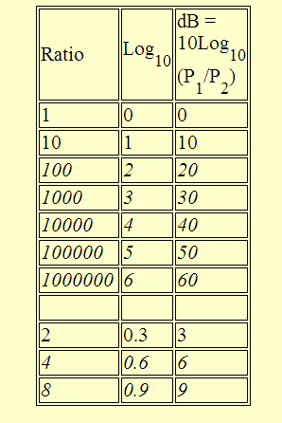
Decibels Review
You can always make a table like this whenever you need to convert to dBs
Some Examples:
The ratio of 16 times = 2 x 2 x 2 x 2 which is +3 dB + 3 dB + 3 dB + 3 dB = + 12 dB.
A gain of 500 is simply 1000 divided by 2 or +30 dB - 3 dB = 27 dB.
1/2000 is - 30 dB – 3 dB = - 33 dB.
-14 dB = -20 dB + 3 dB + 3 dB or -20 dB + 6 dB which is 1/100 x 4 = 1/25th.
Make up some of your own and test it with a calculator.

Slide 67
Decibels Review
When dB’s are absolute values and not ratios:
The use of dB_{m}, dB_{μ}, dB_{w}, etc. is really an abbreviation
An exception to using dB notation for pure ratios is a "shorthand" scheme for indicating a ratio of power compared to a given defined level.
One example is the common artifice of using a subscript such as dBm to indicate Power compared to one milliwatt. Therefore, -3dB_{m} means 1/2 of one milliwatt or 3 dB below 1 milliwatt. Similar notation is used with the Greek letter mu (μ) for dBs compared to a microwatt, as in 10 dB_{μ} to mean 10 microwatts or 1/100th of a milliwatt.
Therefore, -20 dB_{m} = +10 dB_{μ}
Get used to the above--get really comfortable with dBs--as you will encounter all this again in Optical Communications, Satellite, and Wireless courses and FOR THE REST OF YOUR CAREER.

Slide 68
Additional reference materials
Required Textbook:
Antennas and Propagation for Wireless Communication Systems, by Simon R. Saunders and Alejandro Aragon-Zavala, ISBN 978-0-470-84879-1; March 2007 (2nd edition).
Optional References:
Wireless Communications and Networks, by William Stallings, ISBN 0-13-040864-6, 2002 (1st edition);
Wireless Communication Networks and Systems, by Corey Beard & William Stallings (1st edition); all material copyright 2016
Wireless Communications Principles and Practice, by Theodore S. Rappaport, ISBN 0-13-042232-0 (2nd edition)

